Slide 1
Revolutionizing Police Communication
RJPOLICE_HACK_650_Team_PixelCops_1
Welcome to the Police Feedback System, a cutting-edge solution designed to transform communication within law enforcement. Our project aims to enhance collaboration, community engagement, and the overall efficiency of the police department.

Slide 2
Mission and Vision
Mission: Our mission is to create a secure and efficient social media platform tailored for the police department, fostering better communication, collaboration, and community engagement.
Vision: To empower law enforcement agencies with a modern and robust digital tool that enhances their ability to connect with the community, share vital information, and ensure public safety.

Slide 3
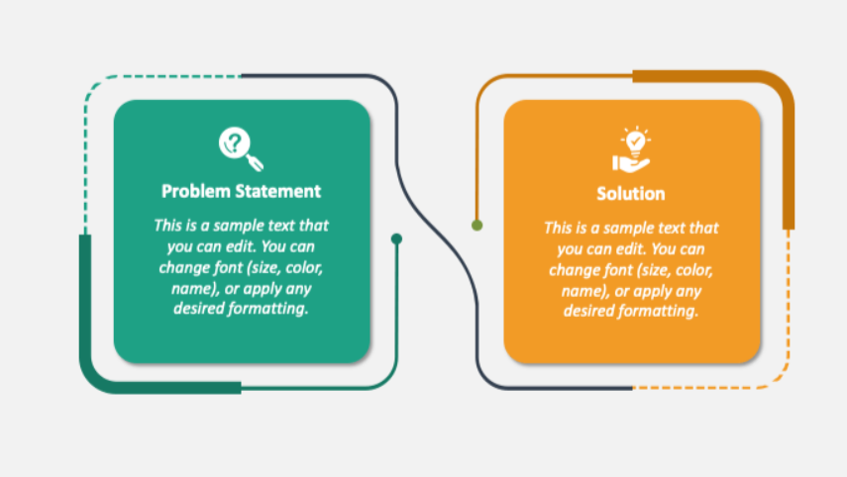
Problem Statement and Solution
Obtaining feedback on police operations is difficult due to outdated methods and privacy concerns.
Traditional communication channels for law enforcement are often slow and lack interactivity.
The Police Feedback System is the solution to communication challenges faced by law enforcement.
It provides a secure and centralized platform for officers to connect, share information, and interact with the community in real-time.

Slide 4
Key Features
Social Media-Like Platform
Online Portal for Detailed Feedback
Secure Authentication
Real-time Communication
Community Engagement
Incident Reporting
Media Sharing
Auto Chatbot
Notification System
Police Station Ranking

Slide 5
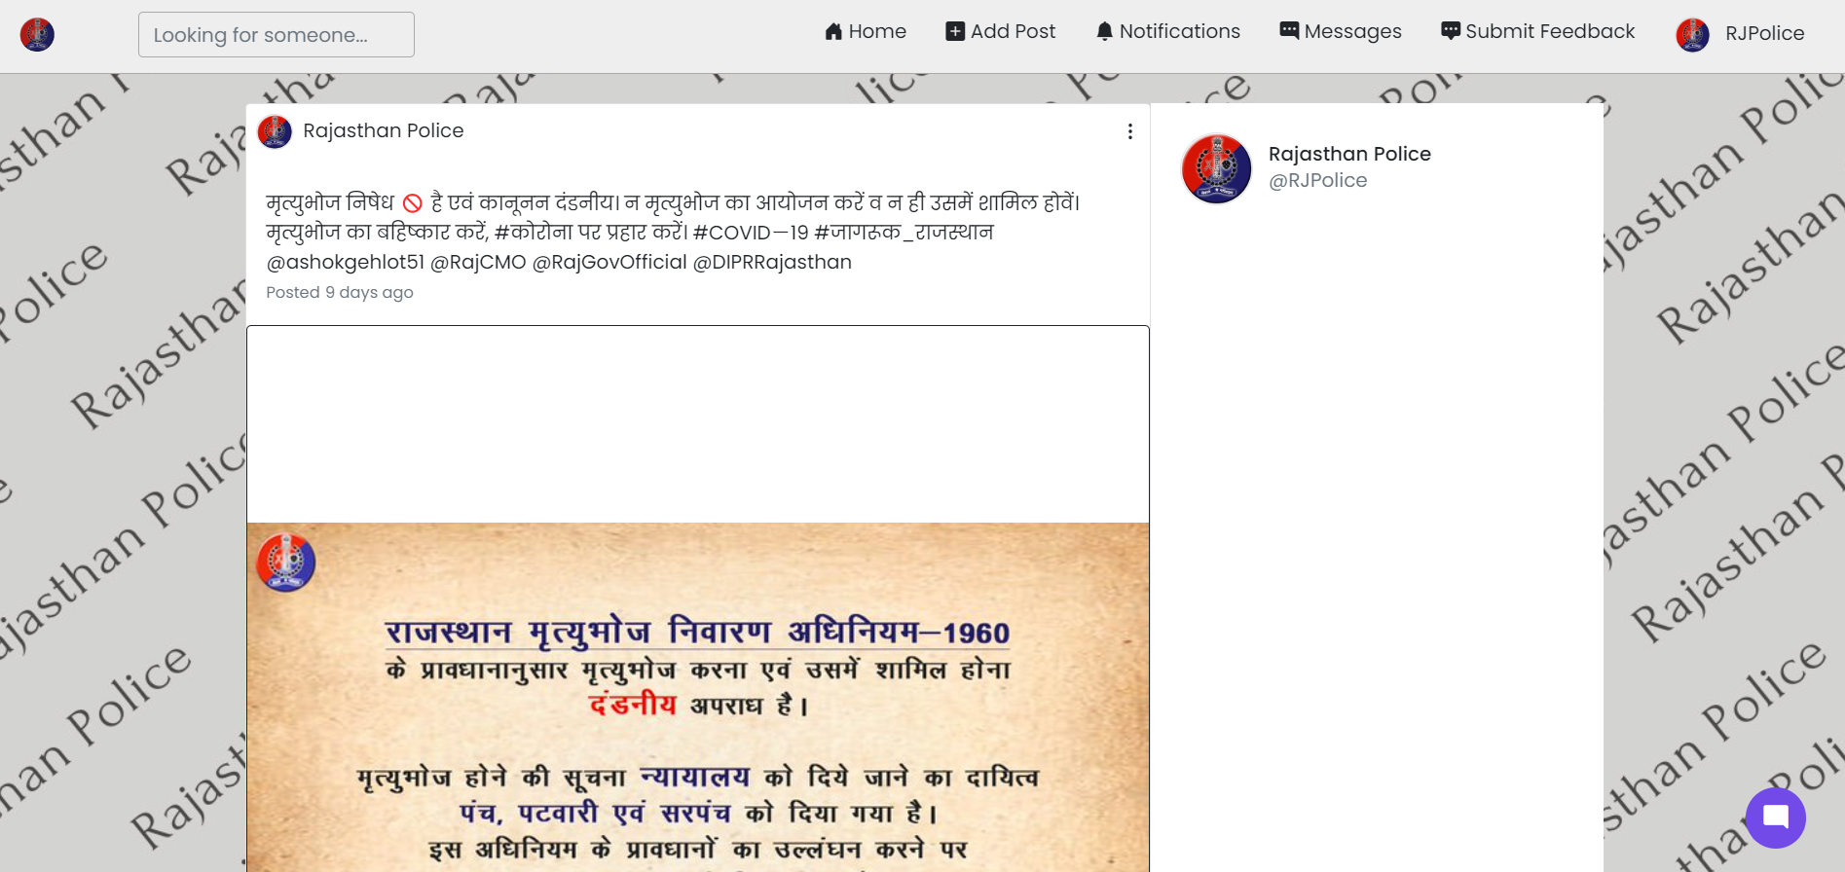
Main Screen

Slide 6
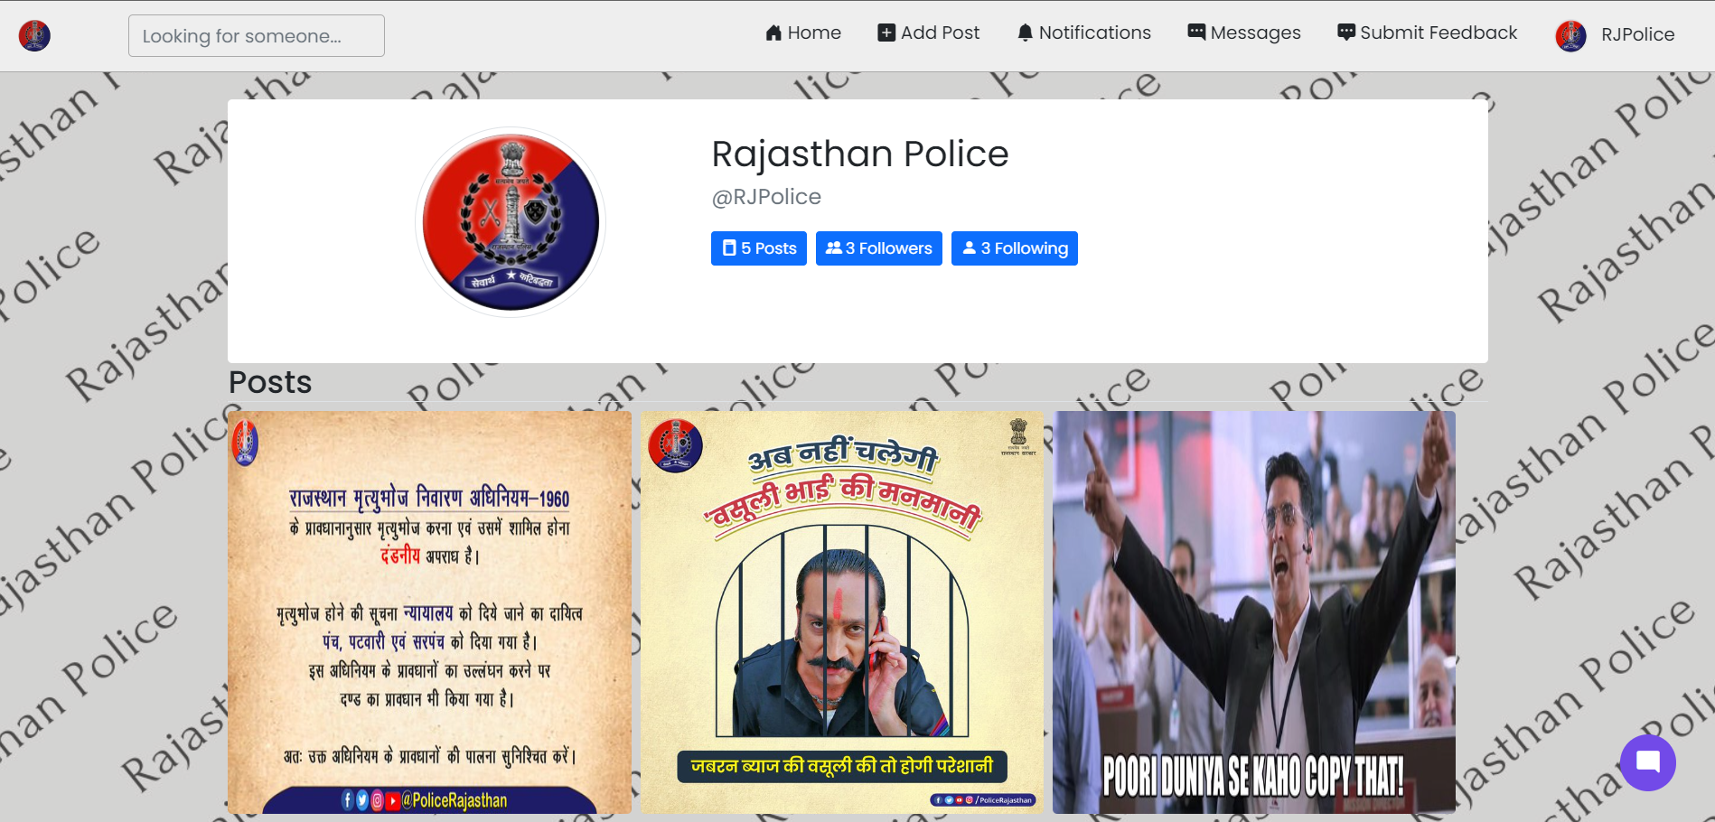
Profile Page

Slide 7
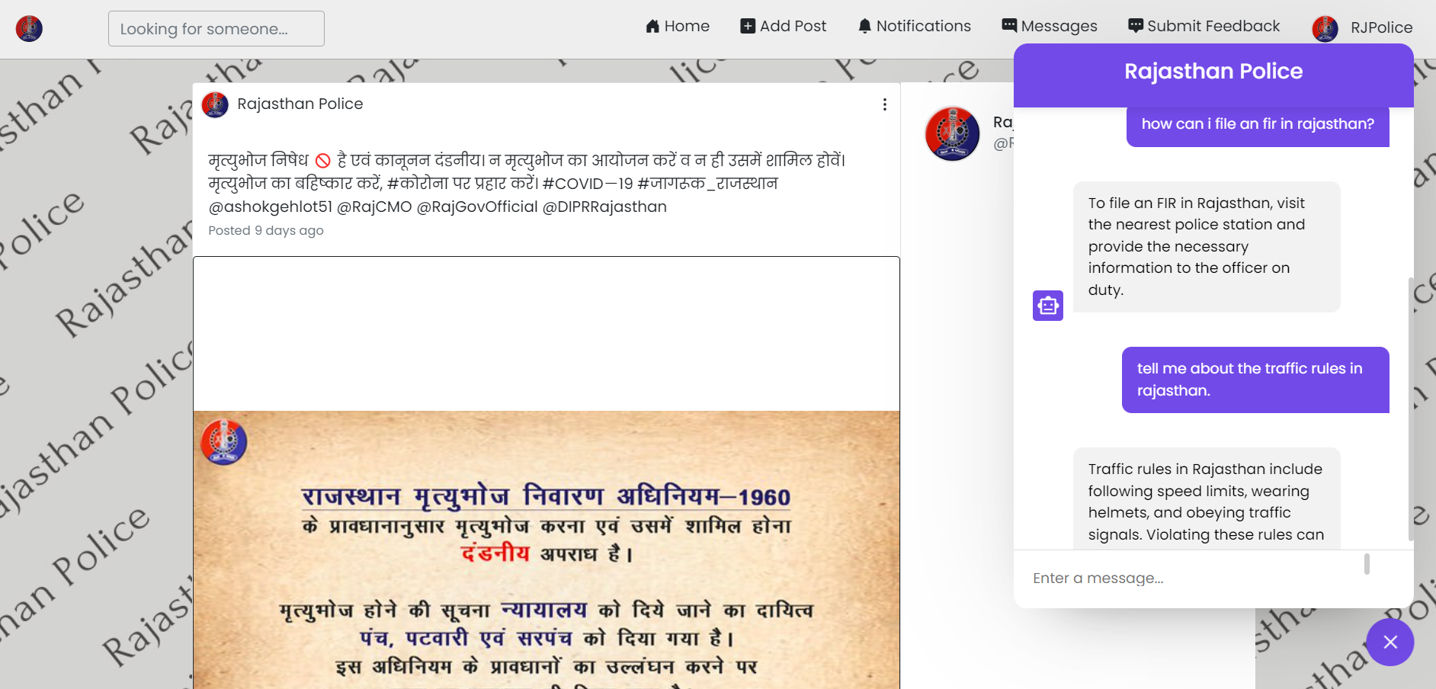
Chatbot

Slide 8
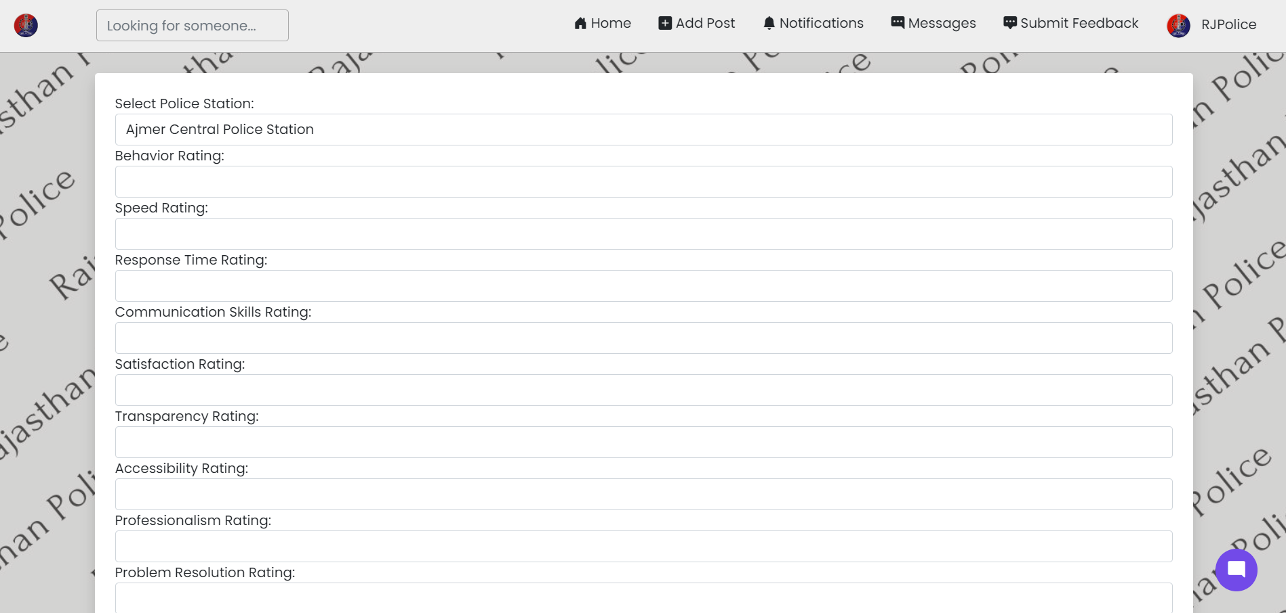
Submit Feedback (User side)

Slide 9
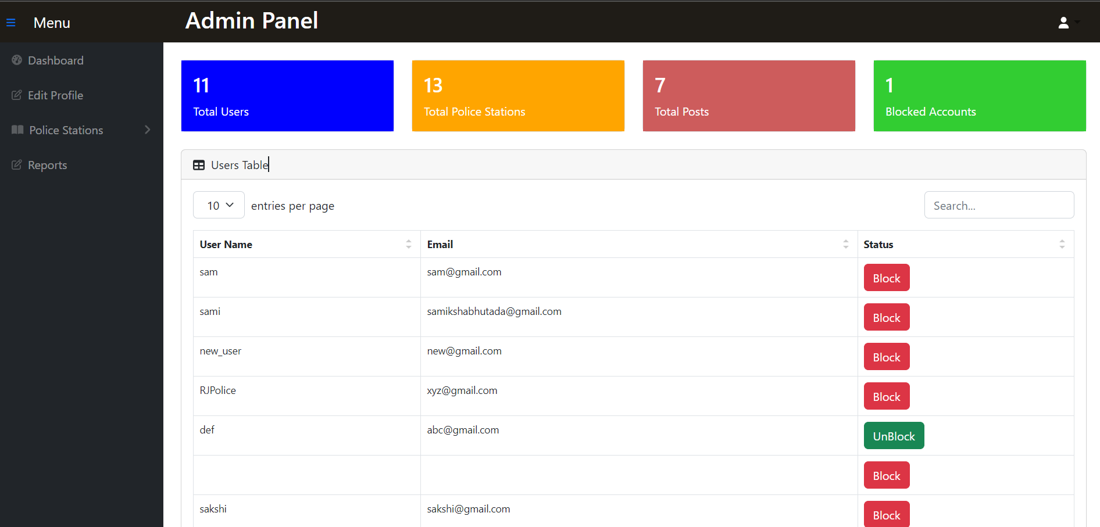
Admin Panel

Slide 10
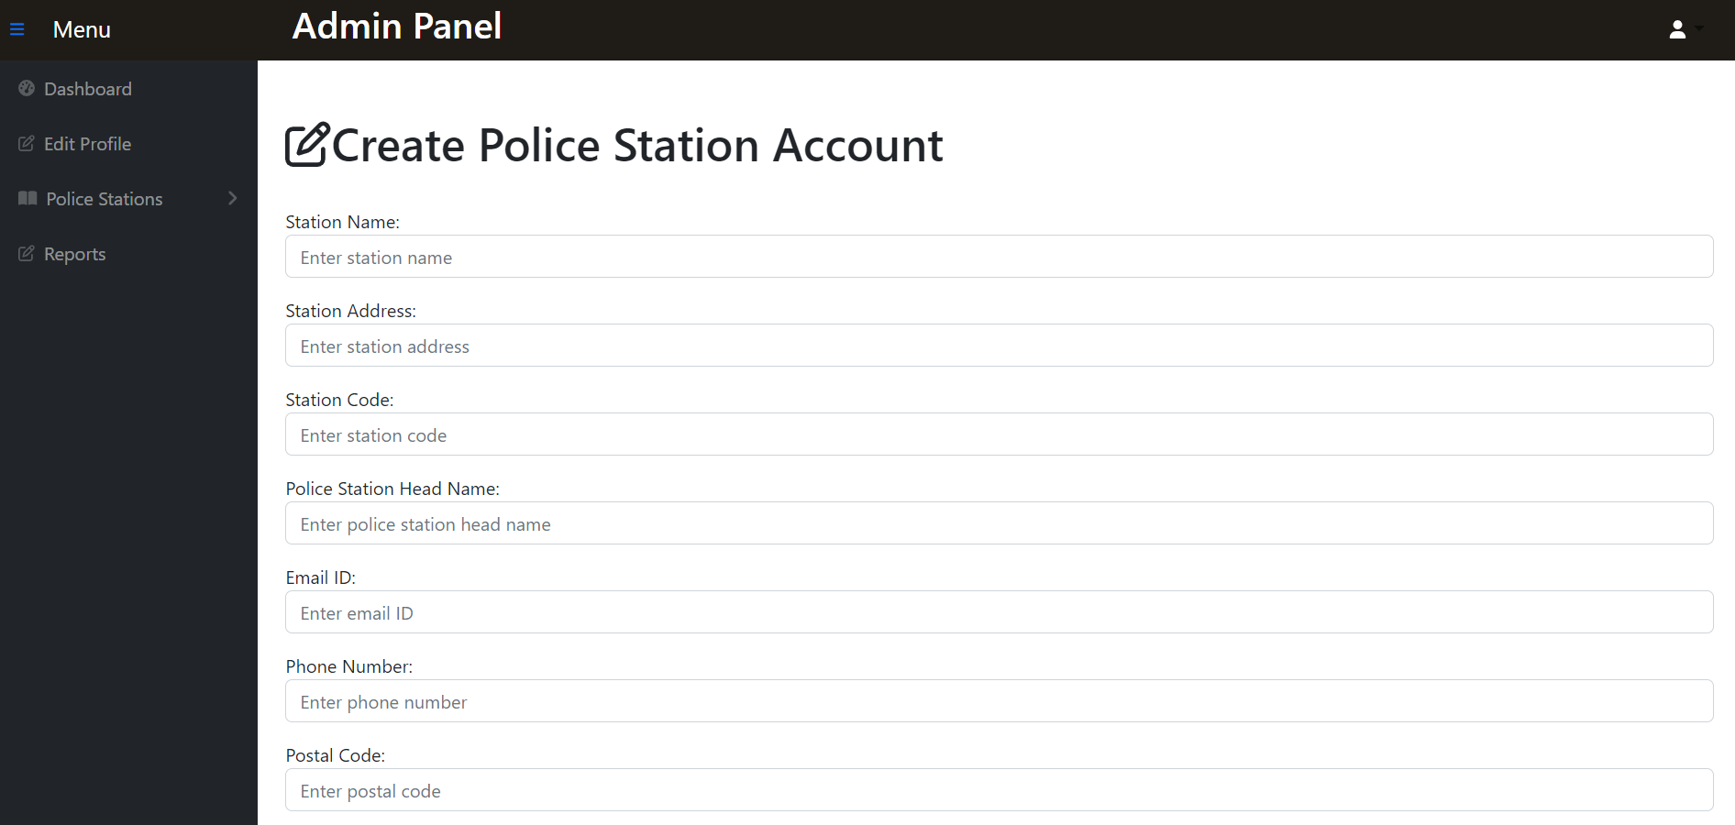
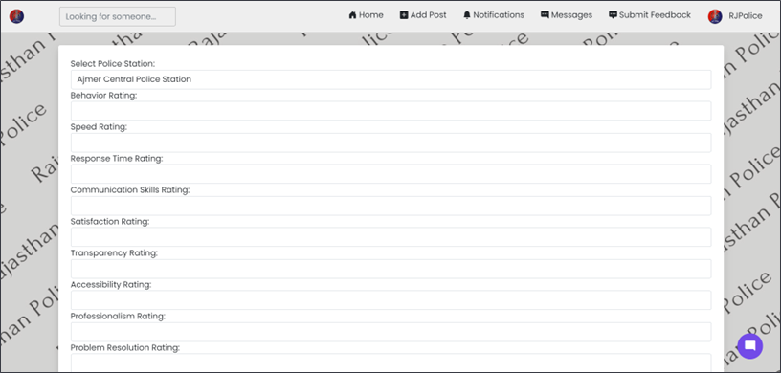
Police Station Creation

Slide 11
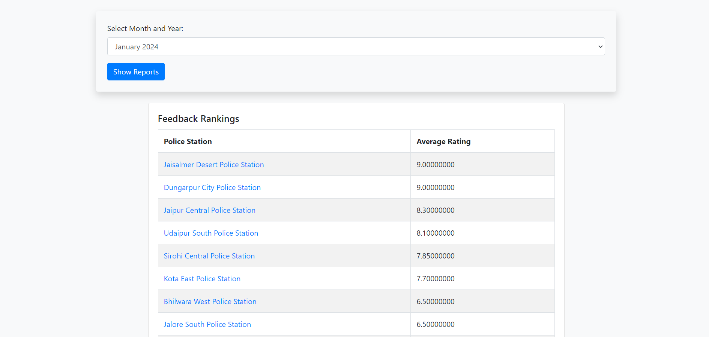
Police Station Ranking

Slide 12
Revolutionizing Law Enforcement Communication
Vedant6800/RJPOLICE_HACK_650_Team_PixelCops_1 aims to revolutionize communication within the police department.
Fostering collaboration, community engagement, and ensuring public safety, our project brings a new era of transparency and efficiency.

Slide 13


